Slide 1
Server Side Programming

Slide 2
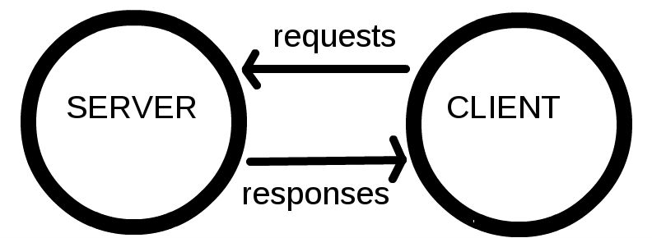
Clients and Servers
Computers connected to the web are called clients and servers.
A simplified diagram of how they interact might look like this:

Slide 3
Clients and Servers
Clients are the typical web user's internet connected devices and web-accessing software available on those devices (usually a web browser like Firefox or Chrome).

Slide 4
Clients and Servers
Servers are computers that store webpages, sites, or apps.
When a client device wants to access a webpage, a copy of the webpage is downloaded from the server onto the client machine to be displayed in the user's web browser.

Slide 5
Basic Terminologies
In addition to the client and the server, we must know about the following:
TCPIP
DNS
HTTP
Component Files

Slide 6
TCP/IP
Transmission Control Protocol and Internet Protocol are communication protocols that define how data should travel across the web over internet.
This is like the transport mechanisms that let you place an order, go to the shop, and buy your goods. In our example, this is like a car or a bike (or however else you might get around).

Slide 7
DNS
Domain Name Servers are like an address book for websites. When you type a web address in your browser, the browser looks at the DNS to find the website's real address before it can retrieve the website.
The browser needs to find out which server the website lives on, so it can send HTTP messages to the right place.

Slide 8
HTTP
Hypertext Transfer Protocol is an application protocol that defines a language for clients and servers to speak to each other.

Slide 9
Component files
A website is made up of many different files, which are like the different parts of the goods you buy from the shop. These files come in two main types:
Code files: Websites are built primarily from HTML, CSS, and JavaScript, though you'll meet other technologies a bit later.
Assets: This is a collective name for all the other stuff that makes up a website, such as images, music, video, Word documents, and PDFs.

Slide 10
Web Server
Web server refers to server software, or hardware dedicated to running said software, that can serve contents to the World Wide Web.
A web server processes incoming network requests over HTTP and several other related protocols
The primary function of a web server is to store, process and deliver web pages to clients.
The communication between client and server takes place using the Hypertext Transfer Protocol (HTTP).

Slide 11
Web Server
On the hardware side, a web server is a computer that stores web server software and a website's component files (for example, HTML documents, images, CSS stylesheets, and JavaScript files).
A web server connects to the Internet and supports physical data interchange with other devices connected to the web.

Slide 12
Web Server
On the software side, a web server includes several parts that control how web users access hosted files.
At a minimum, this is an HTTP server.
An HTTP server is software that understands URLs (web addresses) and HTTP (the protocol your browser uses to view webpages). An HTTP server can be accessed through the domain names of the websites it stores, and it delivers the content of these hosted websites to the end user's device.

Slide 13
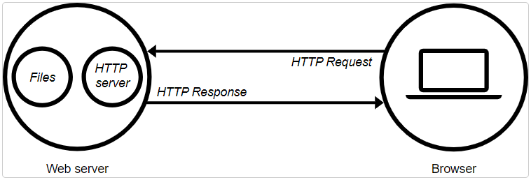
Web Server
At the most basic level, whenever a browser needs a file that is hosted on a web server, the browser requests the file via HTTP.
When the request reaches the correct (hardware) web server, the (software) HTTP server accepts the request, finds the requested document, and sends it back to the browser, also through HTTP.
(If the server doesn't find the requested document, it returns a 404 response instead.)

Slide 14
Server Side Scripting
Scripting or Programming that runs on a webserver.
Processing a form
Managing online purchases
Registering a new user
Booking a hotel room

Slide 15
A server-side dynamic web page
Is a web page whose construction is controlled by an application server processing server-side scripts.
In server-side scripting, parameters determine how the assembly of every new web page proceeds, including the setting up of more client-side processing.

Slide 16
A client-side dynamic web page
It processes the web page using HTML scripting running in the browser as it loads.
JavaScript and other scripting languages determine the way the HTML is parsed into the Document Object Model that represents the loaded web page.
The same client-side techniques can then dynamically update or change the DOM in the same way.

Slide 17
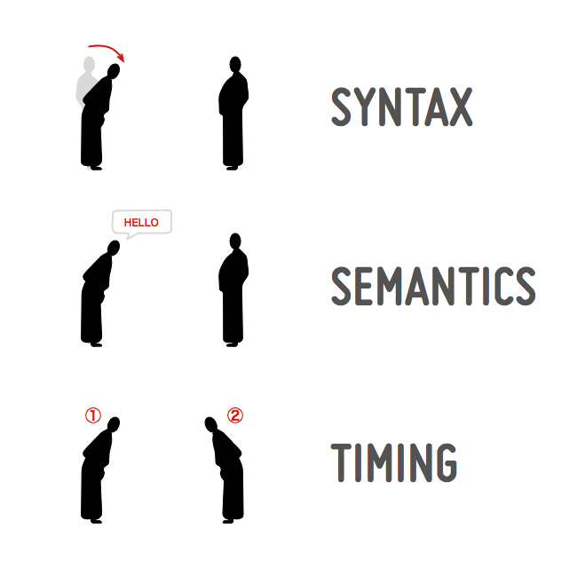
What is a communication protocol?

Slide 18
What is a communication protocol?
Combination of three things:
Syntax (data format and coding)
Semantics (control information and error handling)
Timing (speed matching and sequencing)

Slide 19
What is a communication protocol?
An online communication protocol contains the same elements.
The syntax will be the sequence of characters such as keywords we use for writing the protocols.
The semantics is the meaning associated with each of these keywords
The timing is the order in which two or more entities exchange these keywords.

Slide 20
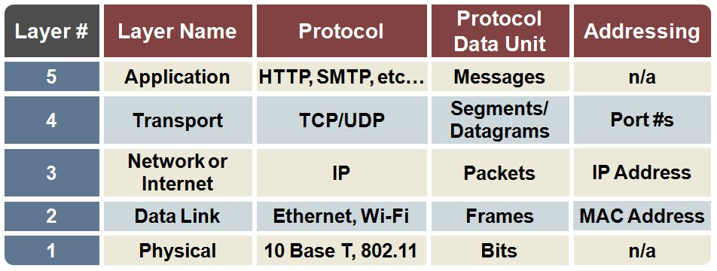
TCP/IP Layers

Slide 21
Communicating Webserver via HTTP
Web server provides support for HTTP.
HTTP specifies how to transfer hypertext (linked web documents) between two computers.
HTTP is a textual, stateless protocol.

Slide 22
Communicating Webserver via HTTP
Textual: All commands are plain-text and human-readable.
Stateless: Neither the server nor the client remember previous communications.
For example, relying on HTTP alone, a server can't remember a password you typed or remember your progress on an incomplete transaction. We need an application server for tasks like that.

Slide 23
Communicating Webserver via HTTP
HTTP provides clear rules for how a client and server communicate.
Usually only clients make HTTP requests, and only to servers.
Servers respond to a client's HTTP request.
A server can also populate data into a client cache, in advance of it being requested, through a mechanism called server push.
When requesting a file via HTTP, clients must provide the file's URL.
The web server must answer every HTTP request, at least with an error message.

Slide 24
Communicating Webserver via HTTP
HTTP server is responsible for processing and answering incoming requests.
Upon receiving a request, an HTTP server checks if the requested URL matches an existing file.
If so, the web server sends the file content back to the browser. If not, the server will check if it should generate a file dynamically for the request (see Static vs. dynamic content).
If neither of these options are possible, the web server returns an error

Slide 25
HTTP Server Push
It is an optional feature of the HTTP protocols that allows servers to send resources to a client before the client requests them.
Server Push is a performance technique aimed at reducing latency by sending resources to a client before it knows they will be needed.
But in practice, Server Push frequently results in wasted bandwidth because the server rarely knows which resources are already loaded by the client and transmits the same resource multiple times, resulting in slowdowns if the resources being pushed compete for bandwidth with resources which were actually requested.

Slide 26
How the web works?
When you type a web address into your browser:
The browser goes to the DNS server, and finds the real address of the server that the website lives on.
The browser sends an HTTP request message to the server, asking it to send a copy of the website to the client.

Slide 27
How the web works?
If the server approves the client's request, the server sends the client a "200 OK" message and then starts sending the website's files to the browser as a series of small chunks called data packets.
The browser assembles the small chunks into a complete website and displays it to you.

Slide 28
Order in which component files are parsed
When browsers send requests to servers for HTML files, those HTML files often contain:
<link> elements referencing external CSS stylesheets
and <script> elements referencing external JavaScript scripts.
It's important to know the order in which those files are parsed by the browser as the browser loads the page.

Slide 29
Order in which component files are parsed
The browser parses the HTML file first, and that leads to the browser recognizing any <link>-element references to external CSS stylesheets and any <script>-element references to scripts.
As the browser parses the HTML, it sends requests back to the server for any CSS files it has found from <link> elements, and any JavaScript files it has found from <script> elements, and from those, then parses the CSS and JavaScript.

Slide 30
Order in which component files are parsed
The browser generates an in-memory DOM tree from the parsed HTML, generates an in-memory CSSOM structure from the parsed CSS, and compiles and executes the parsed JavaScript.
As the browser builds the DOM tree and applies the styles from the CSSOM tree and executes the JavaScript, a visual representation of the page is rendered to the screen, and the user sees the page content and can begin to interact with it.

Slide 31
CSS Object Model (CSSOM)
It is a set of APIs allowing the manipulation of CSS from JavaScript.
It is much like the DOM, but for the CSS rather than the HTML.
It allows users to read and modify CSS style dynamically.

Slide 32
Full Stack Development
Full-stack development refers to the practice of working on both the front end and back end of a web application.
A full-stack developer is skilled in handling all aspects of development, from designing user interfaces to managing databases and servers. They have a broad understanding of various technologies and can work on both client-side and server-side components.

Slide 33
Full Stack Development
Here's a breakdown of the key components of full-stack development:
Front-end development
Back-end development
Databases
Server management and deployment
Version control systems
Additional skills

Slide 34
Front-end development
This involves creating the user interface (UI) and user experience (UX) of the application that users interact with directly.
Front-end developers use languages like HTML, CSS, and JavaScript along with frameworks and libraries like React, Angular, or Vue.js to build responsive, visually appealing, and interactive web interfaces.

Slide 35
Back-end development
The back end is the server-side of the application responsible for managing and processing data, ensuring the application functions correctly.
Back-end developers work with server-side languages such as JavaScript (Node.js), Python (Django, Flask), Ruby (Ruby on Rails), Java (Spring), or PHP (Laravel) to develop server logic, interact with databases, and handle business logic.

Slide 36
Databases
Full-stack developers often work with databases to store, retrieve, and manipulate data. They use database management systems like MySQL, PostgreSQL, MongoDB, or Firebase to organize and manage the application's data efficiently.

Slide 37
Server management and deployment
Full-stack developers should have knowledge of server management and deployment. They need to understand how to deploy applications on servers, configure hosting environments, and manage the application's deployment pipeline.
Notes:
An application's deployment pipeline refers to the automated process of taking code changes from a version control system (such as Git) and systematically moving them through different stages (development, testing, staging, production) to make them available for end-users.

Slide 38
Version control systems
Proficiency in version control systems like Git is crucial for tracking changes, collaborating with other developers, and maintaining the codebase.

Slide 39
Additional skills
Full-stack developers might also need knowledge of APIs, web services, security protocols, and basic design principles to create well-rounded applications.

Slide 40
Full Stack Development Examples
MEAN Stack
MongoDB
MongoDB is a source-available cross-platform document-oriented database program. Classified as a NoSQL database program
Express
Express.js, or simply Express, is a back end web application framework for building RESTful APIs with Node.js
Angular
Developed by Google, Angular is a comprehensive framework that encompasses the entire application development process. It follows the MVC
Node
A server-side JavaScript runtime environment

Slide 41
Full Stack Development Examples
MERN Stack
MongoDB
MongoDB is a source-available cross-platform document-oriented database program. Classified as a NoSQL database program
Express
Express.js, or simply Express, is a back end web application framework for building RESTful APIs with Node.js
React
Developed by Facebook, React is a JavaScript library for building user interfaces. It focuses on the "view" layer of the application, providing a component-based architecture
React framework: along with native platform capabilities.
Node
A server-side JavaScript runtime environment

Slide 42
Full Stack Development Examples
LAMP Stack
Linux
Operating system
Apache
Web server software
MySQL
Relational database management system
PHP
Server-side scripting language

Slide 43
Full Stack Development Examples
Django Stack
Django
A high-level Python web framework
Python
Programming language
SQLite or PostgreSQL or MySQL
Database options often used with Django
HTML/CSS/JavaScript
Front-end technologies

Slide 44
Full Stack Development Examples
Ruby on Rails Stack
Ruby on Rails
A web application framework written in Ruby
Ruby
Programming language
PostgreSQL or MySQL
Database options
HTML/CSS/JavaScript
Front-end technologies

Slide 45
Full Stack Development Examples
Serverless Stack
Architecture or approach to building applications where developers don't need to manage the infrastructure, servers, or underlying hardware.
It does not mean that servers are not involved; rather, it abstracts the infrastructure management away from the developer, allowing them to focus solely on writing code and deploying functions or services.

Slide 46
Full Stack Development Examples
Serverless Stack
AWS Lambda or Azure Functions or Google Cloud Functions: Serverless compute services
Amazon DynamoDB or Azure Cosmos DB or Google Firestore
NoSQL databases
Front-end technologies (React, Angular, Vue.js, etc.)

